Slide 1



CARBON CAPTURE
WEEK 1
Carbon capture and Sequestration

Slide 2

LECTURE 1

Slide 3

TOPIC OUTLINE
Overview of Carbon Cycle
Reservoirs
Flux
Data and Statistics

Slide 4
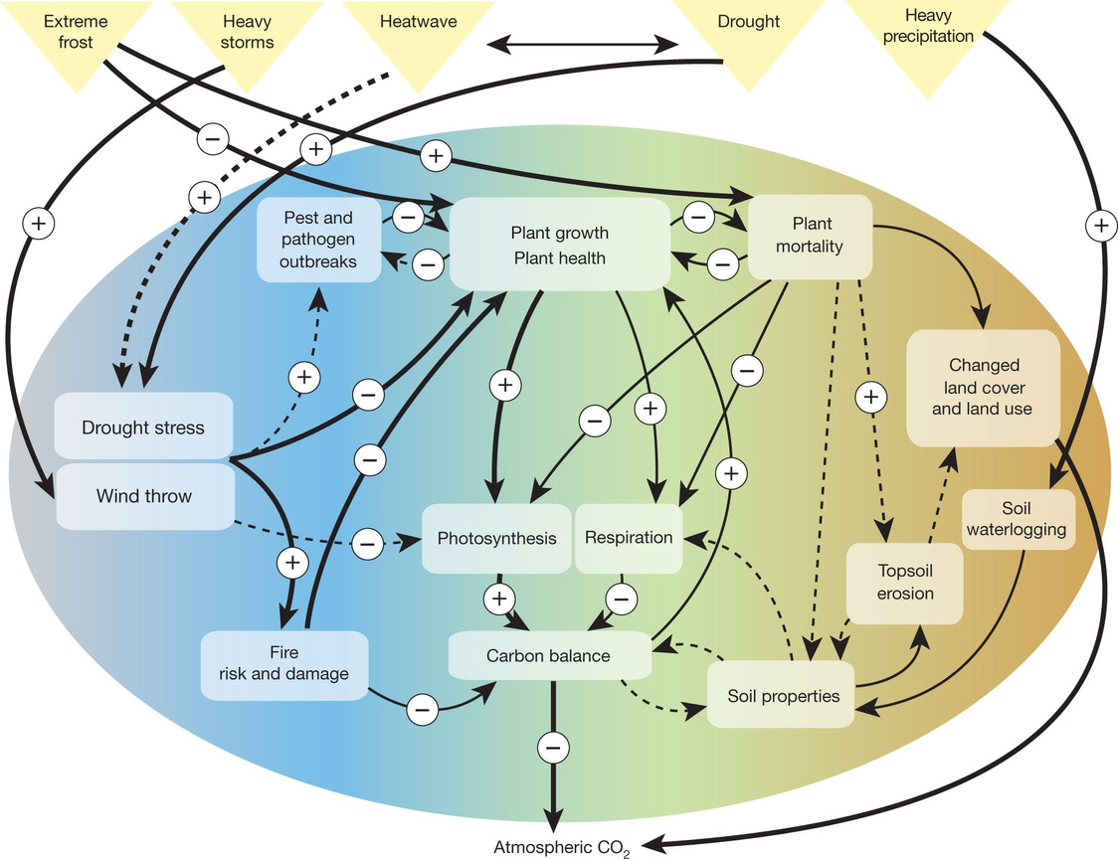
CARBON CYCLE: OVERVIEW
Carbon cycle is basically movement of carbon from one location to another.
Carbon is important for all life on Earth. All living things constitute Carbon. Carbon is produced by both natural and human-made (anthropogenic) sources.
On the shortest time scales, of seconds to minutes, plants take carbon out of the atmosphere through photosynthesis and release it back into the atmosphere via respiration.
On longer time scales, carbon from dead plant material can be incorporated into soils, where it might reside for years, decades or centuries before being broken down by soil microbes and released back to the atmosphere. On still longer time scales, organic matter that became buried in deep sediments (and protected from decay) was slowly transformed into deposits of coal, oil and natural gas, the fossil fuels we use today. When we burn these substances, carbon that has been stored for millions of years is released once again to the atmosphere in the form of carbon dioxide (CO2).

Slide 5

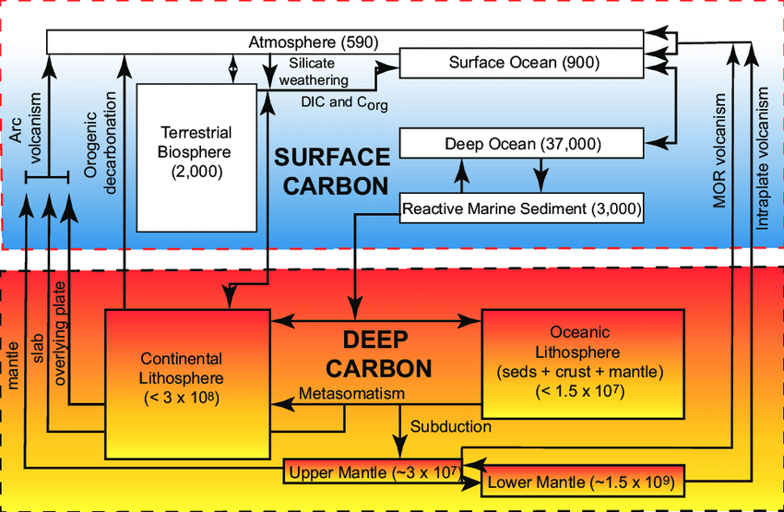
RESERVOIRS
Sources:
Atmosphere: Mostly found as CO2
Lithosphere: As carbonate rocks. Also Found as fossil fuels. Found in soil from dead animals, animal waste.
Biosphere: It is stored in trees.
Hydrosphere: Dissolved in water. Used to produce shells
Carbon is found naturally in various forms. These components from where we get carbon are referred as Carbon Pools or Reservoirs. As they act as storage houses for storing large amounts of Carbon. The Movement of Carbon between Reservoirs is called flux. Fluxes connect Reservoirs together to create cycles and feedback.
.

Slide 6
CARBON POOLS
The Carbon Pools or Reservoirs contain Carbon in extremely large numbers. Commonly used unit for measurement is Pg in Petagrams or 10^15 grams also known as Gigatons.
Largest amount of carbon on Earth is stored In sedimentary rocks and the earth's crust. Approximately 100,000,000 PgC. And another 4000 PgC as the fossil fuel. Oceans contain 38000 PgC.
Presently earth's atmosphere contains 750PgC and this amount is increasing significantly day by day because of deforestation, industries, combustion etc. Before these activities began it was around 560PgC.
FLUX
Fluxes are usually expressed as a rate with units of an amount of some substance being transferred over a certain period of time (e.g. g cm-2 s-1 or kg km2 yr-1).
A single carbon pool can often have several fluxes both adding and removing carbon simultaneously.

Slide 7
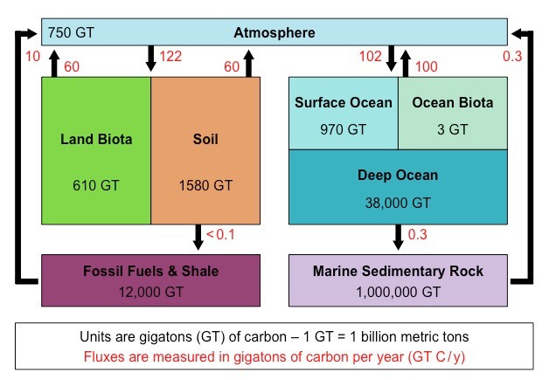
FLUX
Current estimates suggest photosynthesis removes 120 PgC/year from the atmosphere and about 610 PgC is stored in plants at any given time. Plant respiration represents approximately half (60 PgC/year) of the CO2
that is returned to the atmosphere in the
terrestrial portion of the carbon cycle.
Since the onset of the industrial revolution, these fuels have been mined and combusted at increasing rates and have served as a primary source of the energy that drives modern industrial human civilization. At present, fossil fuel combustion represents a flux to the atmosphere of approximately 9 PgC/year.

Slide 8
EFFECT OF CARBON
.The carbon cycle has a large effect on the function and well being of our planet. Globally,
The carbon cycle plays a key role in regulating the Earth’s climate by controlling the concentration of carbon dioxide in the atmosphere. Carbon dioxide (CO2) is important because it contributes to the greenhouse effect, in which heat generated from sunlight at the Earth’s surface is trapped by certain gases and prevented from escaping through the atmosphere. The greenhouse effect itself is a perfectly natural phenomenon and, without it, the Earth would be a much colder place. But as is often the case, too much of a good thing can have negative consequences, and an unnatural buildup of greenhouse gases can lead to a planet that gets unnaturally hot.
In recent years CO2 has received much attention because its concentration in the
the atmosphere has risen to approximately 45% above natural background levels and will continue to rise into the near future. Scientists have shown that this increase is a result of human activities that have occurred over the last 150 years, including the burning of fossil fuels and deforestation. Because CO2 is a greenhouse gas, this increase is believed to be causing a rise in global temperatures. This is the primary cause of climate change and is the main reason for increasing interest in the carbon cycle.

Slide 9

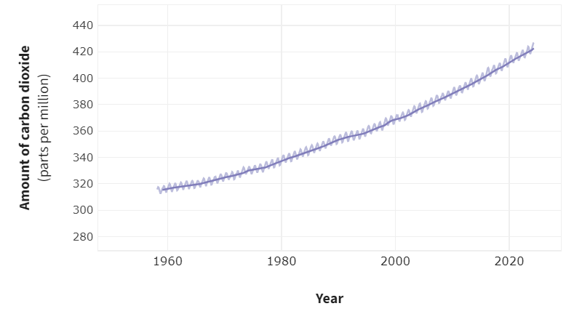
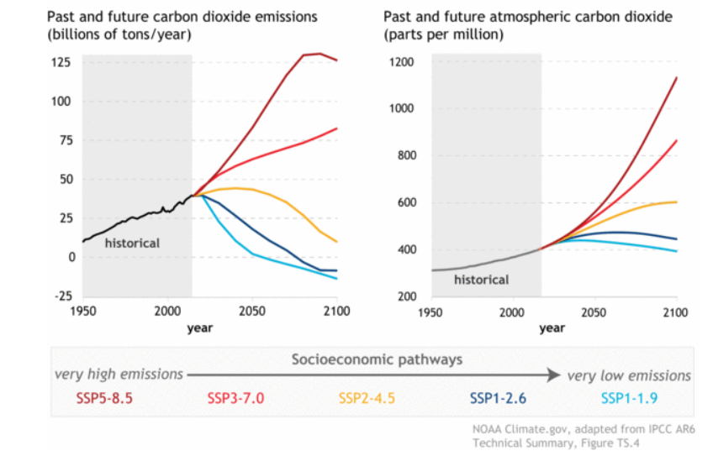
Based on the annual report from NOAA’s Global Monitoring Lab, the global average atmospheric carbon dioxide concentration was 419.3 parts per million (ppm) in 2023, setting a new record high. The increase from 2022 to 2023 was 2.8 ppm, marking the 12th consecutive year with an increase of more than 2 ppm. At Mauna Loa Observatory in Hawaii, where the modern carbon dioxide record began in 1958, the annual average carbon dioxide concentration in 2023 was 421.08 ppm.

Slide 10
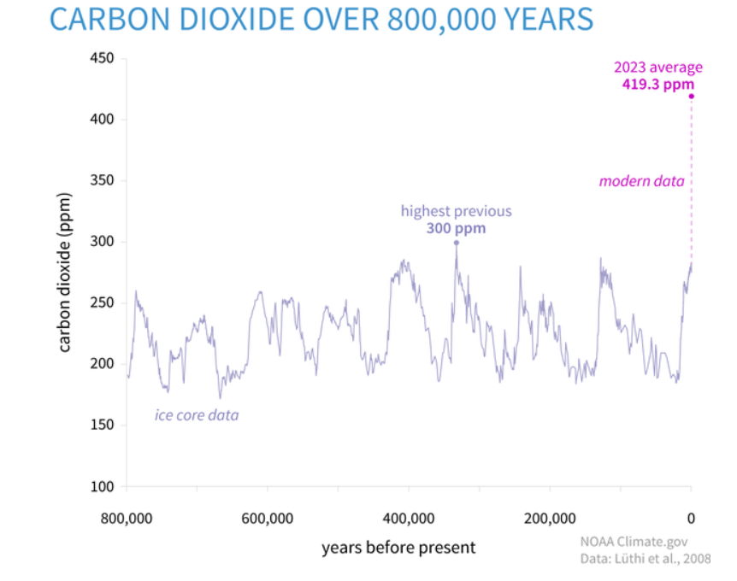
The primary driver of rising carbon dioxide concentrations is the burning of fossil fuels for energy. Fossil fuels like coal and oil contain carbon that plants absorbed through photosynthesis over millions of years; burning these fuels releases that carbon back into the atmosphere in just a few hundred years. Since the mid-20th century, annual emissions from fossil fuel combustion have increased each decade, from nearly 11 billion tons of carbon dioxide per year in the 1960s to an estimated 36.6 billion tons in 2023, according to the Global Carbon Budget 2023.
The overshooting of what natural processes can remove annually accelerates the rise in atmospheric carbon dioxide concentrations. In the 1960s, the global growth rate of atmospheric carbon dioxide was approximately 0.8 ± 0.1 ppm per year. Over the next 50 years, the annual growth rate tripled, reaching 2.4 ppm per year during the 2010s. The annual rate of increase in atmospheric carbon dioxide over the past 60 years is about 100 times faster than previous natural increases, such as those at the end of the last ice age 11,000-17,000 years ago.

Slide 11
THANK YOU

